Slide 1

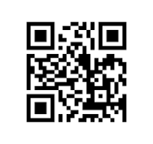

European University of Lefke
Real Time Elevator Monitoring System to Reduce Time and Energy Consumption
Team member names -- Mentor: Project supervisor
Poster Sample
Other Details
A digital poster in vertical format must be prepared for each project. A sample poster image is provided below.
The visual area is located in the middle-left of the poster, and the project info is in the upper navy blue section.
Posters must be prepared according to the specified technical rules and visual standards.
This poster serves as a guide; font sizes and box dimensions can be adjusted as needed for your content.
Ensure all graphics, photos, and charts are high resolution. The goal is to provide a clear, professional overview of your project's innovation, methodology, and social/economic impact.
The posters will be displayed digitally during the exhibition. Please upload your final work in PDF format via the portal.
Poster Specifications
Poster Size: A1 (594x841mm) and Vertical orientation.
Posters must include the University Logo in the top left corner.
In the header area, use specific colors: Project Name (White), University Name (White), Advisor Name (White).
The font should be Calibri, 56pt for the title and 36pt for body text.
Include a QR code in the top right corner is provided in the website, you must update it.
Poster content should include: Abstract, Methodology, Results, and References.
Genç Beyinler Yeni Fikirler KIBRIS
Project Market and Graduation Projects Competition

